Slide 1
DIETARY REQUIRMENT FOR DIFFERENT AGE GROUP
Dr. Swapna Dutta
HoD, Dept. of Home Science

Slide 2
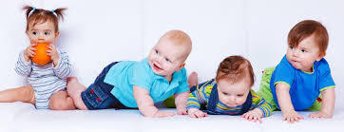
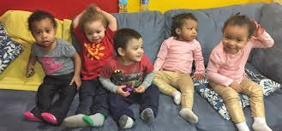
DIETRY REQUIRMENT OF 0-3 YEARS CHILDREN

Slide 5
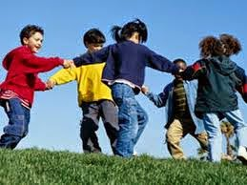
3-6 Years Children

Slide 6
SCHOOL GOING CHILDREN

Slide 7
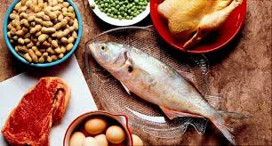

Slide 10
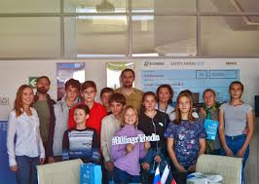
ADOLESCENCE
11-14 Years Children
13-16 years Children

Slide 17
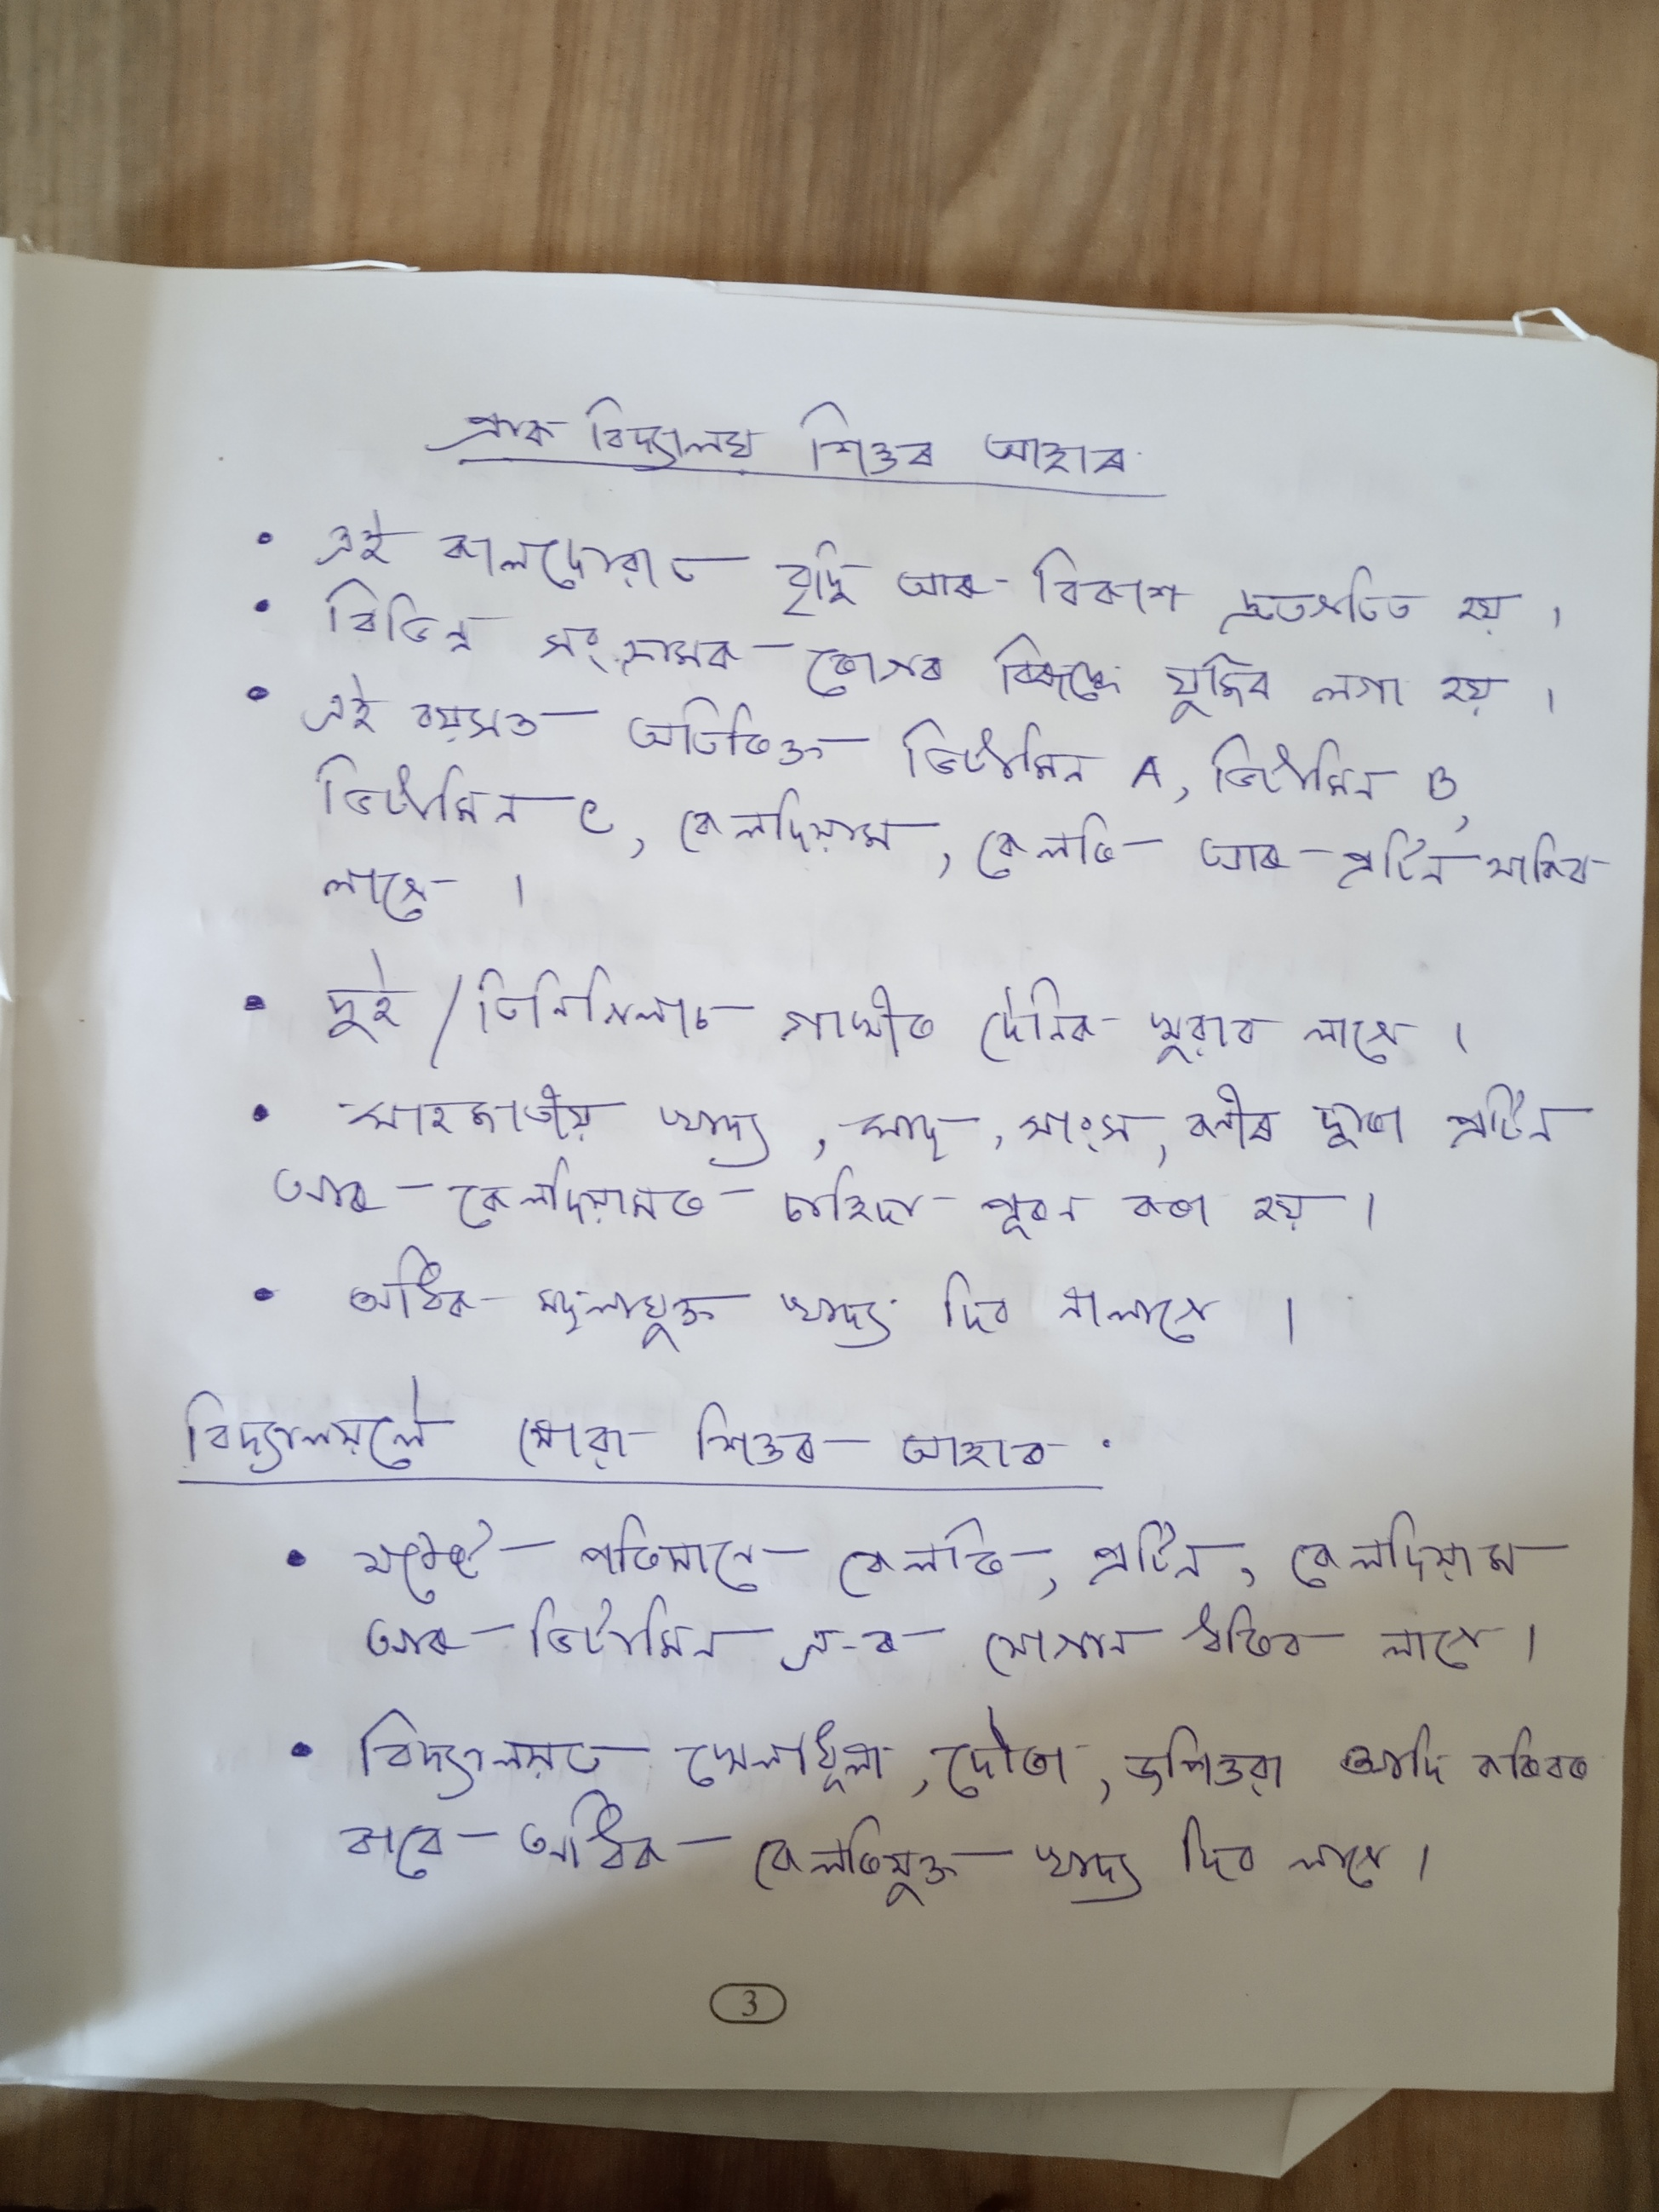

Slide 22
THANK YOU

